Slide 1
PIP2001 Capstone Project
Review-4
PROJECT TITLE :- PSCS235 A one Stop Solution focusing on Tourism
Batch Number: CIT-G06
Student Name | Roll Number
Puneeth N | 20221LIN0004
Rohan Gowda A | 20221LIN0003
Ajin V Joseph | 20221LIN0007
Under the Supervision of,
Dr Shanthi S
Associate Professor
School of Computer Science and Engineering
Presidency University
Name of the Program: Btech CSE(IoT)
Name of the HoD: Dr. Anandaraj S P
Name of the Program Project Coordinator: Dr. Sharmasth Vali Y
Name of the School Project Coordinators: Dr. Sampath A K / Dr. Abdul Khadar A / Mr. Md Ziaur Rahman

Slide 2

Introduction
"Travel Eazy" is an advanced Python-based web application that leverages machine learning to provide personalized travel recommendations and a streamlined booking experience for users exploring destinations across India. The platform includes two primary modules: Admin and User. In the Admin module, administrators can add extensive information about tourist attractions, regional cuisine, and popular activities specific to various Indian states, creating a rich, curated database for travelers. Users can register and log in to access this tailored information and receive destination suggestions based on their health conditions and personal preferences, courtesy of a machine learning model. This model assesses user inputs to recommend locations that best align with individual needs and interests, ensuring an enjoyable and optimal travel experience. Additionally, users can easily add their selected destinations to a cart, enabling seamless booking and simplifying the travel planning process. "Travel Eazy" aims to make travel planning accessible, efficient, and highly personalized for every traveler.

Slide 3
Literature Review
The tourism industry has undergone a significant transformation over the past few decades, largely driven by advancements in digital technology and the changing expectations of modern travelers. The concept of a One-Stop Solution for Tourism is rooted in the increasing demand for integrated, streamlined platforms that enhance user convenience and provide comprehensive travel services in a single digital ecosystem. This literature review explores the evolution of tourism platforms, user preferences, technological innovations, and the future of one-stop solutions in the travel sector.

Slide 4
Proposed Method
The proposed "Travel Eazy" application addresses the limitations of traditional systems by offering a centralized platform for travel planning in India. Through its Admin module, it provides comprehensive and updated information about tourist destinations and experiences. The machine learning integration allows for personalized travel recommendations based on user inputs, ensuring that travelers receive tailored suggestions.

Slide 5
Objectives
The primary objective of "Travel Eazy" is to develop an intuitive web application that enhances the travel planning experience for users in India through the integration of machine learning and a robust administrative interface. By allowing administrators to add and manage comprehensive information about tourist destinations, local cuisine, and activities, the project ensures that users have access to valuable and up-to-date resources. The machine learning component aims to personalize user experiences by analyzing individual preferences and health-related inputs to provide tailored travel recommendations. Furthermore, the application seeks to simplify the booking process, allowing users to seamlessly add chosen destinations to a cart and finalize travel arrangements. Overall, "Travel Eazy" aims to streamline the travel planning journey, making it more efficient, user-friendly, and accessible for a diverse range of travelers.

Slide 6
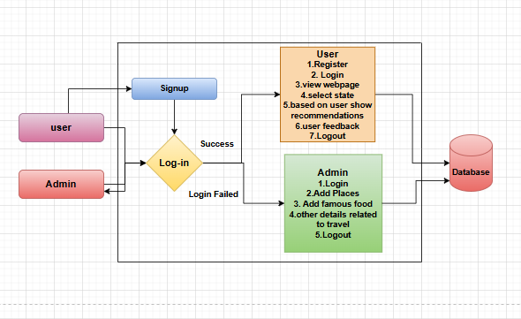
Architecture

Slide 7
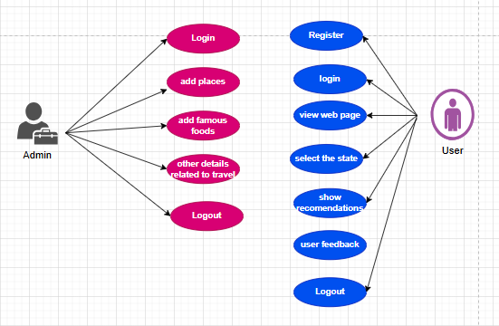
Use Case Diagram

Slide 8
Existing Outcomes
Existing digital marketplaces for artisans typically feature role-based user management, enabling admins to oversee platform operations, artisans to showcase and manage their products, and customers to browse and purchase items. They utilize modern technologies like React.js for responsive frontends, Spring Boot for scalable back ends, and MySQL for reliable data storage. Additionally, these platforms support community interactions, event management, promotional tools, and secure checkout processes to enhance user experience and foster artisan growth

Slide 9
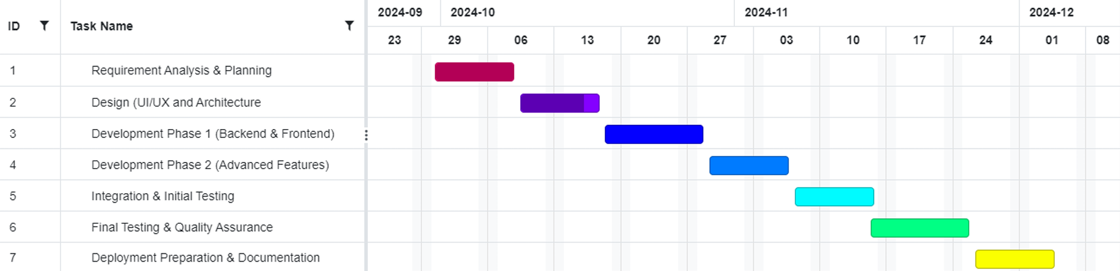
Timeline of Project

Slide 10
Expected Outcomes
Future enhancements for "Travel Eazy" can include integrating AI-powered chatbots to offer real-time assistance and guidance for travelers, addressing queries about destinations, itineraries, and accommodations. Expanding machine learning capabilities to provide more dynamic recommendations based on evolving user preferences and feedback could further enhance personalization. Incorporating predictive analytics would allow for insights into optimal travel times and forecasting travel trends. Adding multilingual support and collaborating with local businesses for exclusive offers and discounts can also elevate user engagement. Finally, implementing a review and rating system for destinations and services could enrich the platform’s recommendations, enabling users to make informed choices based on authentic experiences from the Travel Eazy community.

Slide 11
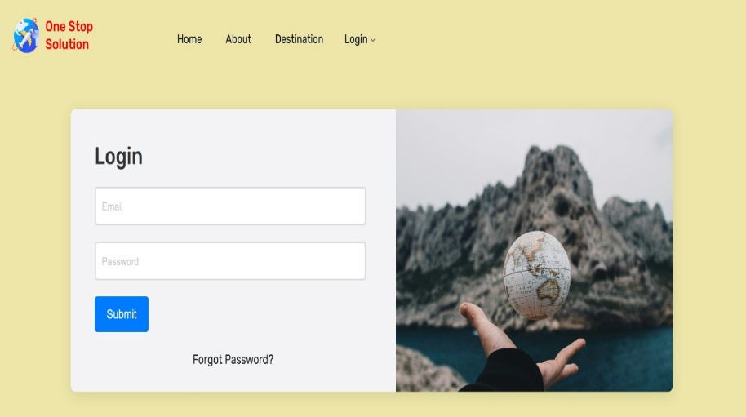
Output

Slide 12
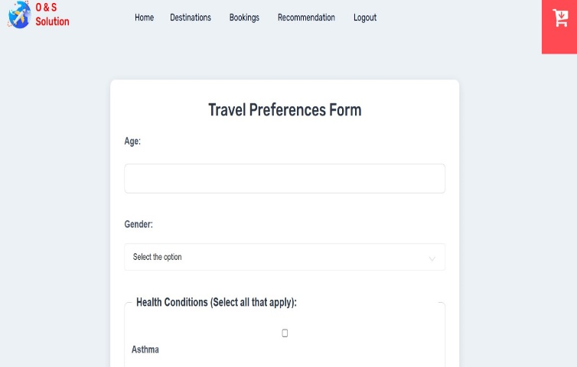
Output

Slide 13
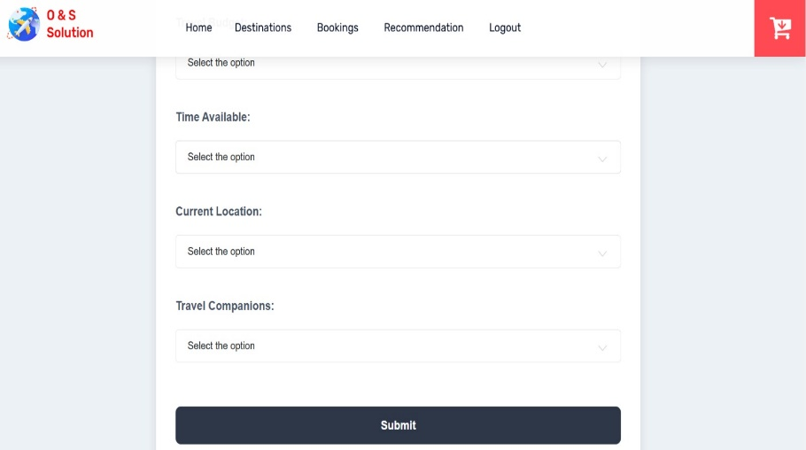
Output

Slide 14
Conclusion
In conclusion, "Travel Eazy" offers a transformative approach to travel planning, enhancing user experiences with personalized, AI-driven recommendations. By analyzing health conditions and individual preferences, the machine learning model tailors destination suggestions to meet users’ unique needs, ensuring a safer and more enjoyable journey. The Admin module's curated content on tourist spots, local cuisine, and activities enables users to explore India’s cultural diversity in depth. The seamless integration of features like a booking cart simplifies the entire planning process, making it both user-friendly and efficient. Ultimately, "Travel Eazy" stands out as an innovative solution that not only makes travel accessible but also creates a more personalized, enjoyable, and convenient experience for users across India.

Slide 15
References
Kumar, A., & Kaur, K. (2020). "Mobile Applications in Indian Tourism: Opportunities and Challenges." Journal of Tourism and Hospitality Management, 8(1), 45-56.
Prasad, R. (2018). "Impact of Mobile Technology on Tourism in India." International Journal of Hospitality & Tourism Systems, 11(1), 15-22.
Bhardwaj, P., & Singh, S. (2019). "Emerging Trends in Digital Marketing for Tourism in India." International Journal of Tourism and Hospitality Reviews, 6(2), 78-85.
Sethi, V., & Kapoor, S. (2021). "Role of Mobile Apps in Promoting Indian Tourism: A Study." Journal of Tourism Research & Hospitality, 10(1), 102-110.
Sharma, J. P., & Sood, A. (2020). "Tourism and Mobile Technology: The Indian Scenario." Global Journal of Research in Tourism and Hospitality Management, 3(2), 100-107.
Choudhary, S. (2017)."The Role of Technology in Enhancing the Tourism Experience in India." Tourism Management Perspectives, 21, 45-52.
Rathi, N., & Singh, R. (2019)"User Acceptance of Mobile Apps in Indian Tourism." International Journal of Tourism Research, 21(5), 612-620.
Sahu, P. K., & Mohanty, S. (2022) "Digital Transformation in Indian Tourism: A Focus on Mobile Applications." Journal of Travel & Tourism Marketing, 39(3), 345-360.
Ghosh, A. (2021) "Understanding the Role of Mobile Technology in Indian Heritage Tourism." Heritage & Society, 14(1), 24-39.
Nayak, J. K., & Jha, R. (2023) "Evaluating Mobile Applications for Travel Planning in India." Tourism Review, 78(4), 803-819.

Slide 16
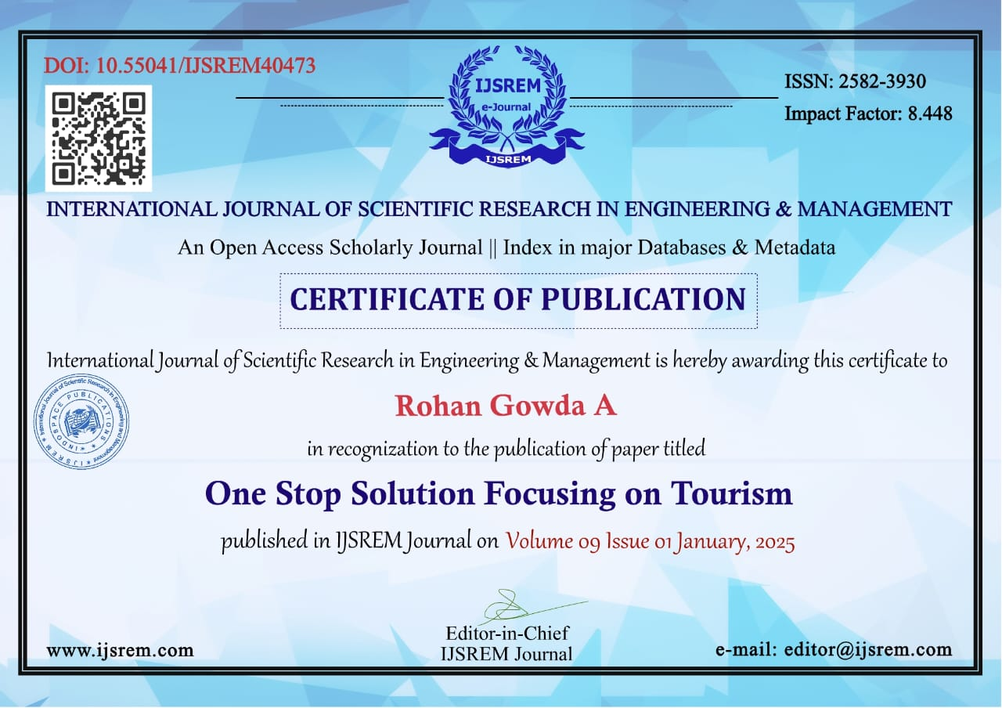
Certificate

Slide 17
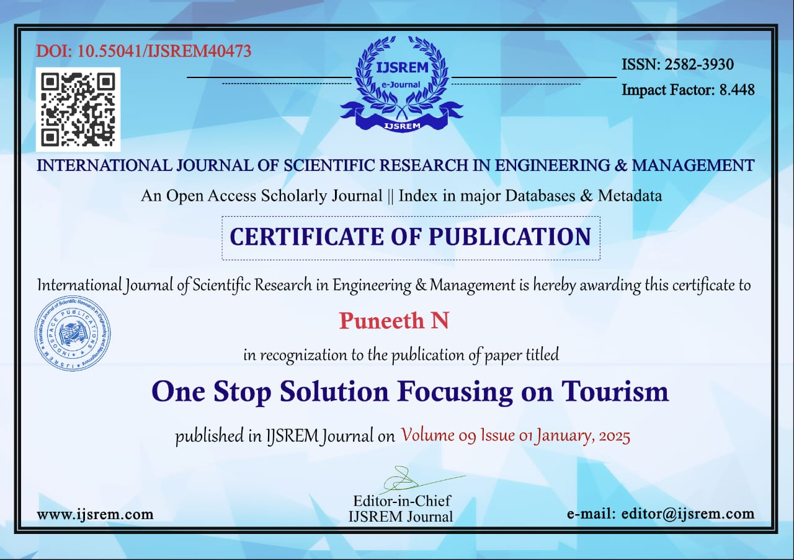
Certificate

Slide 18
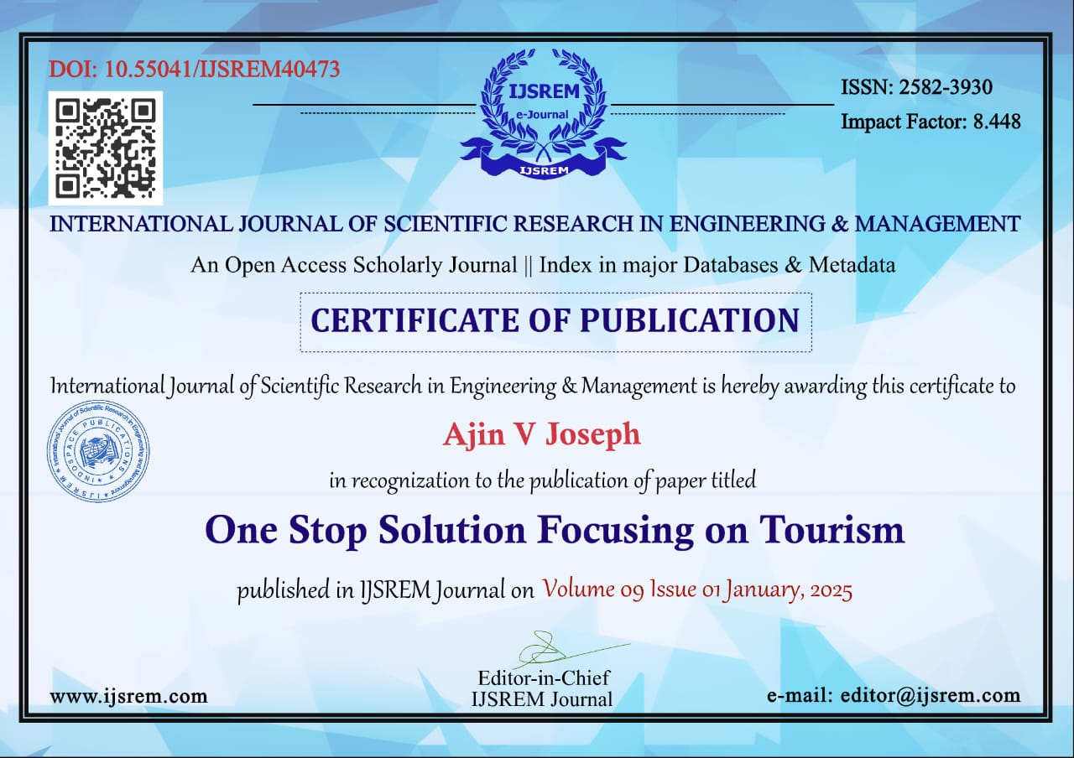
Certificate

Slide 19

Certificate

Slide 20
Thank You

